Slide 1

GameCo
Marketing Budget Presentation
2017
Rich Seiler

Slide 2

Which MARKET should we invest in?

Slide 3

Current Understanding
Video game sales have remained the same for various geographical regions (North America, Europe, and Japan) over time.

Slide 4
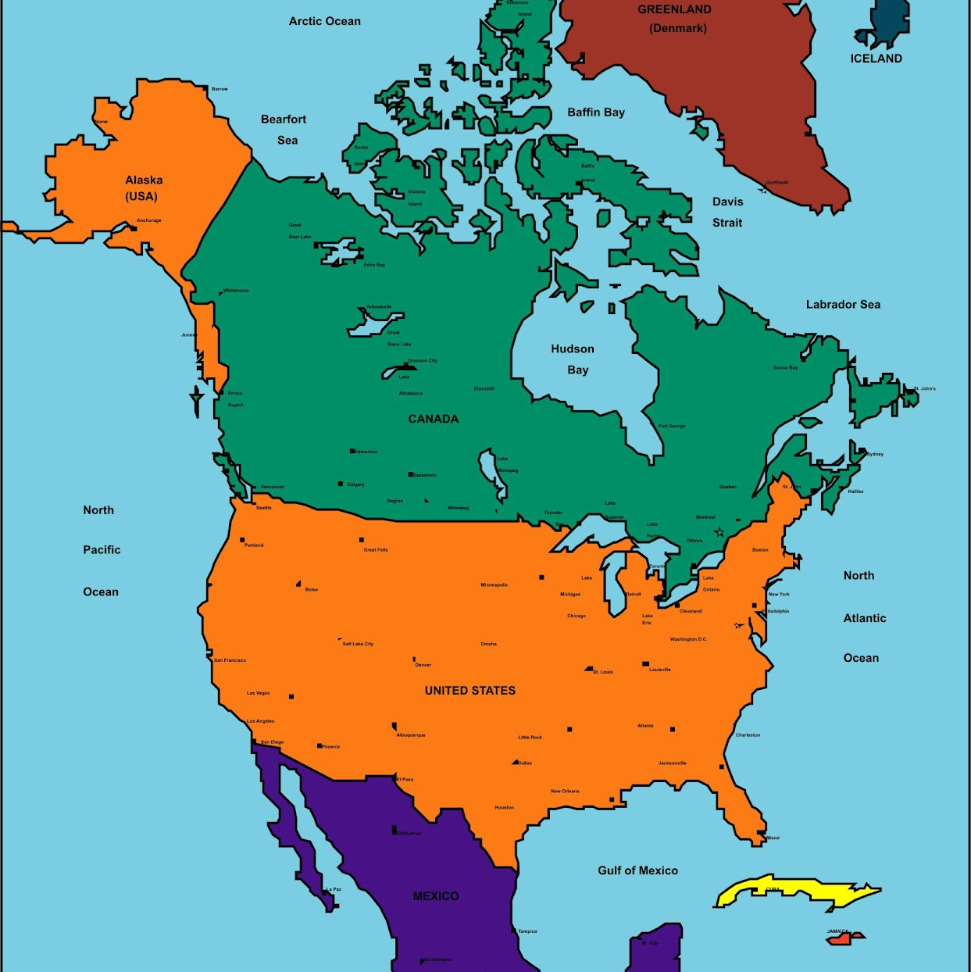


Market insight
North America
Europe
Japan
Started off as the leader in video games sales leader from 1980 – 1985
Fell behind Japan during the late 80’s and early 90’s
Returned to dominance from 1996 – 2015
Slipped behind European sales last year
Started off slow in the 80’s with less than a 10% market share
Moved into second place in the late 90’s, overtaking Japan
Maintained consistent growth in the 2000’s
Became the leader in video game sales in 2016
Went from 0% to 48% in 1983
Bounced between first and second place during the late 80’s and early 90’s
Peaked in 1993 with a 55% market share
Slipped into last place (among the three markets) in 1998 and has never been above 20% since 2001

Slide 5
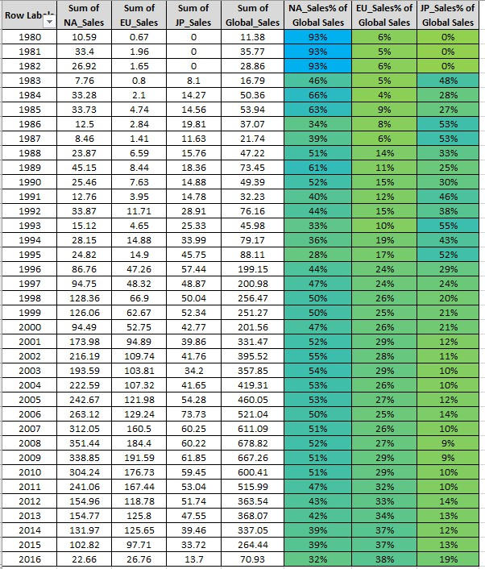
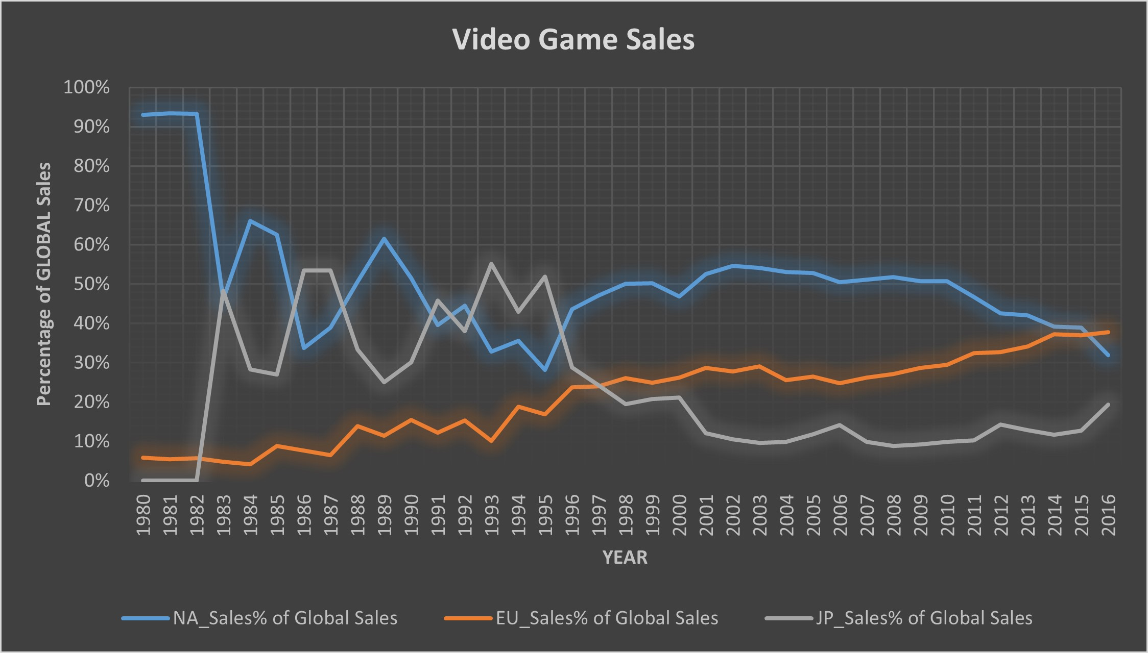
The European video game market is on the rise

Slide 6

Revised Understanding
The Japanese and North American markets are showing signs of decline. The European market has shown consistent growth over the past 20 years. This is where we should invest.

Slide 7
Which Platform should we invest in?

Slide 8
Current Understanding
There are many different video game platforms. We would expect for a few to stand out above the rest as we look at European sales from 2010 – 2016.

Slide 9
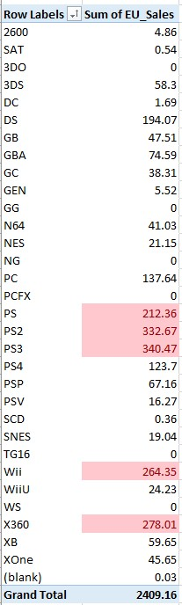
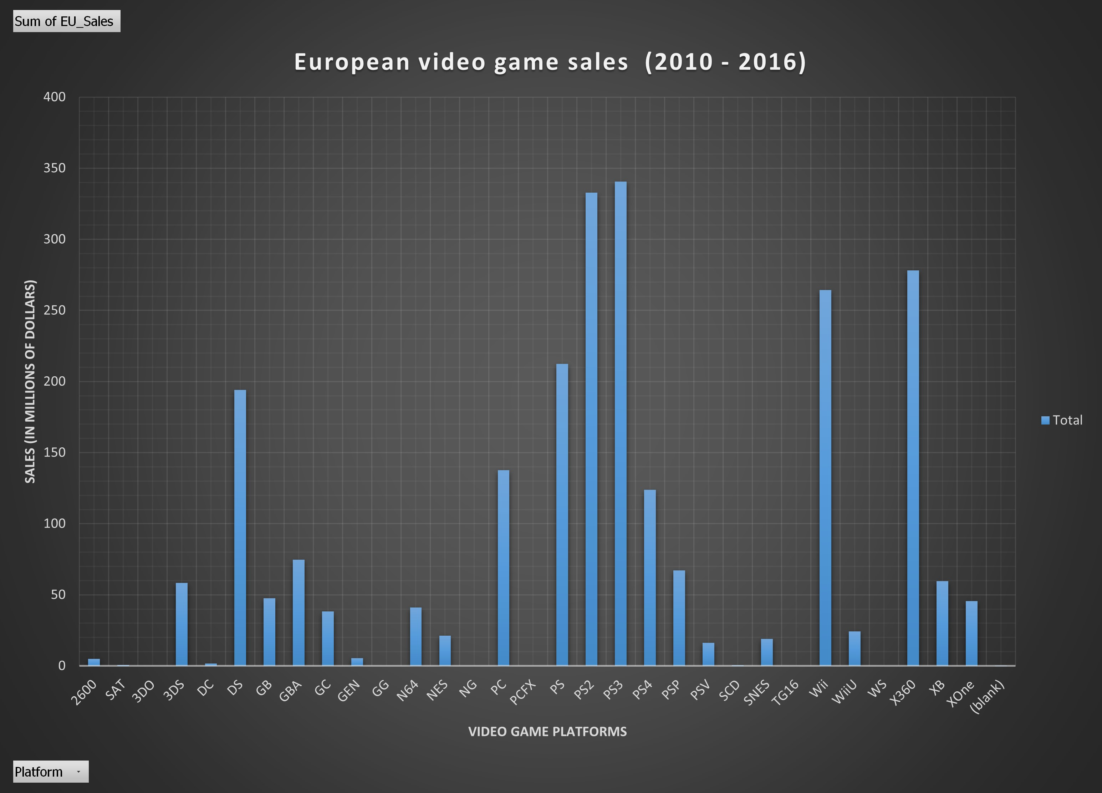
Are there Three good options to invest in?

Slide 10
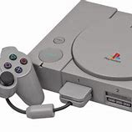
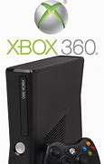
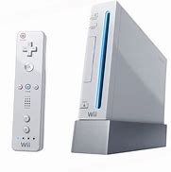
Market insight
Playstation 4
Xbox 360
Wii
Was popular from 2013 - 2016
Peak popularity was 2015
Over $50M in sales in 2015
Over $17M in sales in 2016
Was popular from 2006 to 2015
Peak popularity was 2010
Less than $5M in sales in 2015
Less than $1M in sales in 2016
Was popular from 2006 to 2009
Peak popularity was 2009
Less than $1M in sales in 2015
No sales shown for 2016

Slide 11
Revised Understanding
While the historical data shows that there’s three good options, the recent trend shows that PlayStation 4 is the best platform to invest in.

Slide 12
Which Genre should we invest in?

Slide 13
Current Understanding
There are many different video game genres. We would expect for a few to stand out above the rest as we look at Playstation 4 video game sales in Europe from 2010 – 2016.

Slide 14
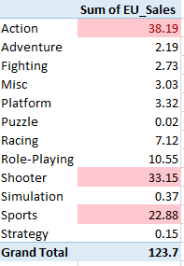
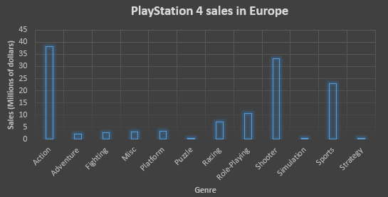
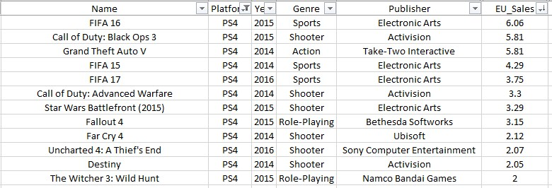
Are there Three good options to invest in?

Slide 15



Market insight
Action games
Shooter games
Sports games
G.T.A. 5 was the top selling video game in Europe in 2014
Assassin’s Creed was just outside the Top 12 with two games barely under $2M in 2014 and 2015
The Last of Us sold $1.87M in 2014
Uncharted: The Nathan Drake Collection sold $1.69M in 2015
50% of the top-12 selling PS4 games in Europe are shooter games
Call of Duty: Black Ops 3 was the best-selling game in this category with $5.81M in sales
Call of Duty: Advanced Warfare, Star Wars Battlefront, Far Cry 4, Uncharted: A Thief’s End, and Destiny all made $2M or more
Three of the top-5 selling video games in Europe are sports game, specifically FIFA games
FIFA 16 was the best-selling video game for the PS4 in Europe
FIFA 17 was the top-selling video game for the PS4 in 2016
FIFA 15 was the second-best selling video game in 2014

Slide 16
Revised Understanding
While there are three good options, I’d recommend investing in the FIFA video game for the PS4 in Europe because it consistently performs well every year.

Slide 17

Thank you!
Rich Seiler
Data Analyst
RichSeiler77@gmail.com
813-816-1656

